Slide 1
Geoffrey Chaucer and The Canterbury Tales

Slide 2
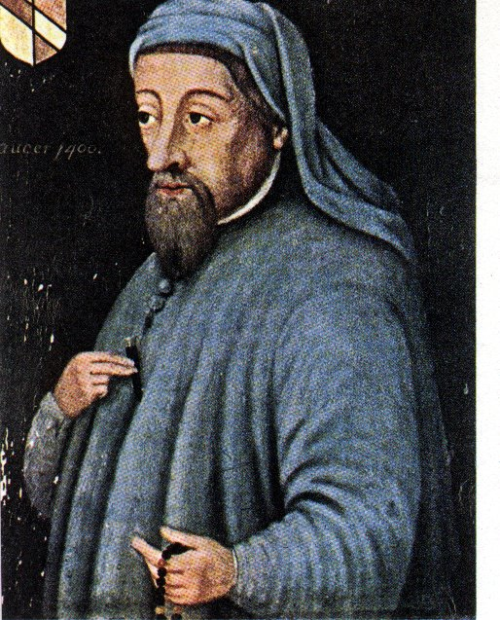
Early Life
Born c. 1340
Son of a prosperous wine merchant
In mid teens, he was placed in the service of the Countess of Ulster so he could obtain more education and be schooled in court and society life
Thus, he would have learned Latin and some Greek as well as perhaps some French and Italian

Slide 3
Chaucer the Writer
Wrote in the vernacular – common language of the people (English)
Served as a soldier, government servant, and member of Parliament
Introduced iambic pentameter
First writer buried in Westminster Abbey

Slide 4
Table Partner Question
Why do you think it was significant that Chaucer wrote in the common language of the people?

Slide 5
Answer
The fact that Chaucer wrote in English (Middle English), rather than French or Latin like many of his fellow writers, meant that ordinary folk could enjoy The Canterbury Tales and their vivid characters.

Slide 6
Chaucer’s Plan
A Prologue followed by a series of stories and linking dialogues and commentaries
Each character would tell 2 stories going and 2 stories coming home…uh… coming home from WHERE?
Canterbury of course. After all, his work IS called : The Canterbury Tales

Slide 7
The Journey Begins…
Chaucer uses a religious pilgrimage to display all segments of medieval England.
The Canterbury Tales begins with a Prologue,
Narrator, presumably Chaucer himself, meets 29 other pilgrims at the Tabard Inn, located in a suburb of London.
As the pilgrims prepare for their journey, the host of the Inn, Harry Bailey, sets a challenge:
Each pilgrim tell two stories on the way to Canterbury and two stories on the return trip. The person who tells the best tale will be treated to a feast hosted by the other pilgrims.

Slide 8
The Journey continued…
The Canterbury Tales is actually a story about stories, twenty-four different tales set within the overarching tale of the pilgrimage.
Definition:
Frame Story – a story within a story
The Outer Frame Story is about the pilgrims meeting at the Tabard Inn preparing for a journey to Canterbury.
The Inner Frame Story would be all the stories told by the assembled pilgrims along their journey to and from Canterbury.

Slide 9
Snapshots of the Era
In the Prologue, Chaucer sketches a brief but vivid portrait of each pilgrim, creating a lively sense of medieval life.
The description may literally describe an article of clothing, but figuratively imply something about that character.
Definition: Satire - a literary composition, in verse or prose, in which human folly and vice are held up to scorn, derision, or ridicule.
Like sarcasm . . . He says one thing, but means another.
Our job is to read and comprehend the literal description of each pilgrim, and then, we must figuratively interpret what Chaucer is trying to imply about that pilgrim’s character.

Slide 10
Snapshots Continued…
Also, so that we might better understand his satirical characterization, Chaucer creates SATIRIC NORMS.
A SATIRIC NORM is a character that represents the perfect ideal.
We can then see how BAD everyone else is by comparing them to this Satiric Norm.

Slide 11
Table Partner Work
With your table buddy-write an quick example of satire or satirical norms criticizing someone well known in society (note-don’t criticize classmates). Then you will share with your quadrants.
Example of satire: “Kim Kardasian should really be given a medal of honor for her contributions to helping youth find a purpose in life. She a shining example of how you have to work hard to achieve your dreams even when you come from a poor background.”
Example of satirical norm: “Freddy Famous was a true example for all youth aspiring to contribute to the world. He came from a poor background and taught himself to read by the age of four. He soon was walking 10 miles a day to get to his community center to participate in plays. After years of hard work he finally achieved fame as an actor in hollywood, but remained humble, living in a small apartment in his hometown. He donates 70% of his yearly income to the community center where he got his start and works with the youth of his hometown every weekend. Parties, drugs, expensive cars, and wasting money are not part of his vocabulary.”

Slide 12
Snapshots Continued…
In the Prologue, Chaucer examines three segments of Medieval England:
1. The Old Feudal order – these are all of the pilgrims associated with the feudal class system.
Knight, Squire, Yeoman, Plowman . . .
2. The Merchant Class – this was the rising middle class of the time; towns and cities were emerging and therefore necessitated the need for skilled services:
Merchant, Man of Law, Guildsmen, Cook . . .
3. The Ecclesiastical (Church) Class – these were all of the members of the church. Chaucer is most critical of this segment of his society.
Prioress, Monk, Friar, Pardoner . . .

Slide 13
A Literary Tour
Chaucer uses the popular genres of his time when he creates the inner stories of the various pilgrims:
Romances (tales of chivalry)
The Wife of Bath’s Tale
Fabliaux (short, bawdy, humorous stories)
The Miller’s Tale
The stories of saint’s lives, sermons
The Parson’s Tale
Allegories (narratives in which characters represent abstractions such as Pride or Honor).
The Pardoner’s Tale
Chaucer wrote much of the Tales using his own form, the heroic couplet, a pair of rhyming lines with five stressed syllables each.

Slide 14
Literary Analysis
Each character in The Canterbury Tales represents a different segment of society in Chaucer’s time. By noting the virtues and faults of each, Chaucer provides social commentary, writing that offers insight into society, its values, and its customs. While reading, draw conclusions from the characters about Chaucer’s views on English society.

Slide 15
Table Partner Work
If Chaucer were writing this today, what members of society do you think he would write about? List some.

Slide 16
But why go to Canterbury?
One answer: Religion
Canterbury has always been an important religious center in England.
St. Augustine (seen in stained glass from the Canterbury Cathedral) was sent by Pope Gregory the Great to establish the Catholic faith in the country
Religion played an important part in medieval life.

Slide 17
Why was religion important?
It’s the Middle Ages
Plague
Warfare
High Infant Mortality Rate
Short Life Expectancy
…and if you were a peasant, you lived your whole life in harsh conditions
About the best thing that you had to look forward to was dying and going to heaven

Slide 18
Also, Canterbury was a Pilgrimage Site
People of all classes went on pilgrimages to holy sites to ask for help with medical, financial or other problems.
The Shrine of St. Thomas à Becket is also located there.

Slide 19
St. Thomas à Becket
Becket was a trusted adviser and friend of King Henry II. Henry named Becket Archbishop of Canterbury.
Becket’s outspoken style angered the King. One day, Henry complained, “Will no one rid me of this meddlesome priest?” Three knights rode to Canterbury where they found Becket at the altar of Canterbury Cathedral.
Becket was murdered at the altar.

Slide 20
A Saint is made…
The death of Becket angered the peasants who felt his Saxon heritage made him one of them.
Canterbury Cathedral became a site for pilgrims to offer prayers to St. Thomas.
Today, a modern cross made from swords marks the site of the martyrdom.
A close-up of the altar.

Slide 21
In Closing
The late fourteenth century world was still very much one of the spoken word. Books were copied out by hand and were a rare luxury until the advent of the printing press 70 years later. The educated elite could read, but they preferred to hear texts read out loud for entertainment. The Canterbury Tales, with their earthy humor and vivid dialogue, were a runaway success.

Slide 22
So, let’s travel back to London, to the area called Southward, and stop at the Tabard Inn. We’ll meet the characters and hear their stories.

Slide 23
The story begins...

