Slide 1
The middle Ages
An Introduction to the times

Slide 2
The middle Ages
500 -1500
Western and northern Europe
“Medieval”- Latin : medius
Urbanization for the first time
Early Middle Ages, the High Middle Ages, and the Late Middle Ages

Slide 3
Map of Europe in 998.

Slide 4
FEUDALISM
1) A political, economic, and social system based on loyalty and military service.
2) In other words, the king awarded land grants or "fiefs" to his most important nobles, his barons, and his bishops, in return for their contribution of soldiers for the king's armies.

Slide 5
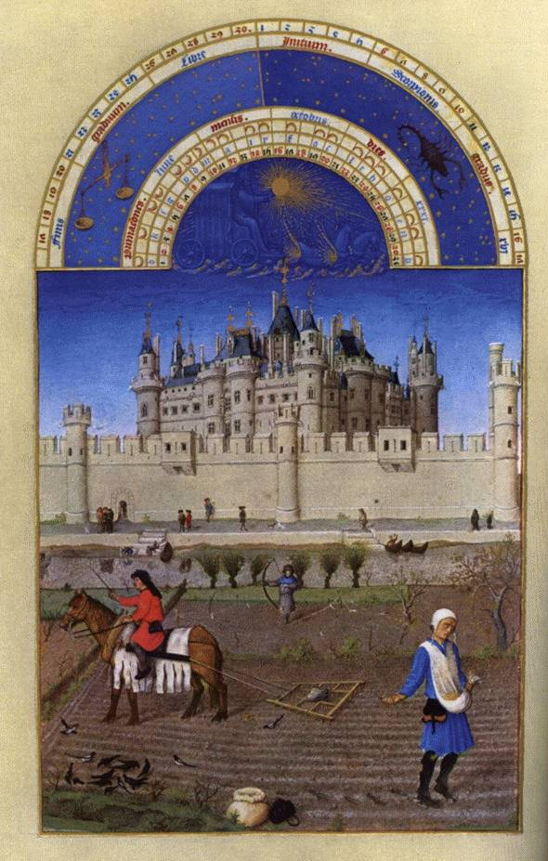
SERFS
Bound to lord for life
Needed permission to marry
Under protection of lord
Not allowed to leave land

Slide 6
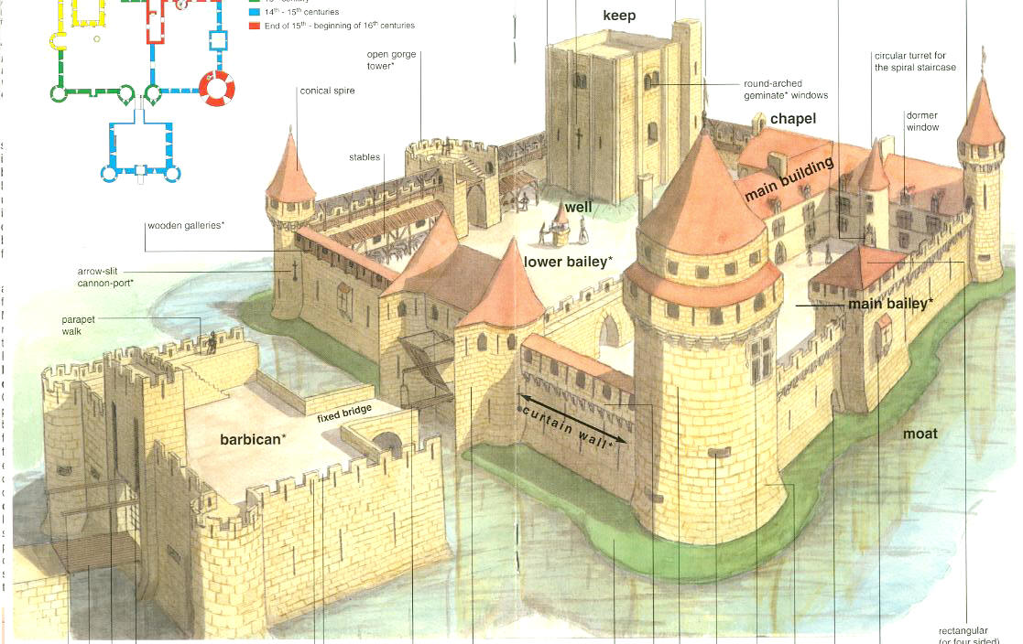
Castles
*Could only be built by the approval of the king
*Used for defense
*Everything the king or nobles needed would be found inside the house

Slide 7
The church
During the Middle Ages, the Church was a major part of everyday life. The Church served to give people spiritual guidance and it served as their government as well. In Europe during the Middle Ages the only recognized religion was Christianity, in the form of the Catholic religion. The lives of the Medieval people of the Middle Ages was dominated by the church. From birth to death, whether you were a peasant, a serf, a noble a lord or a King - life was dominated by the church. Various religious institutions became both important, rich and powerful.

Slide 8
Knighthood
KNIGHT – 18-22 yrs
SQUIRE – 13-16 yrs
PAGE – 7/8 yrs

Slide 9
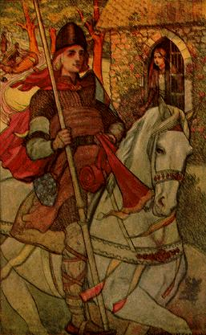
Page
A boy started on his way to knighthood at about the age of seven or eight. At this time, he was sent to a Lord's castle to be trained for knighthood. This young trainee was known as a page. During his time as a page, he learned about horses, armor and weapons.
Age 7/8
Serving in household
Learning swordplay
Playing chess and other strategy games
Hunting with hawks and falcons
Learning code of courtesy expected of knight

Slide 10
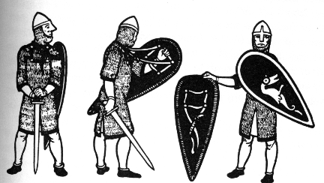
squire
At the age of fourteen the page became a squire. Squires had to follow their master on the battlefield to protect him if he would fall. From the 13th century, squires fought on the battlefield beside their knight.
Age 13 – 16
Acting as personal servant to knight
Learning jousting
Assisting knight in battle
Taking charge of prisoners captured in battle

Slide 11
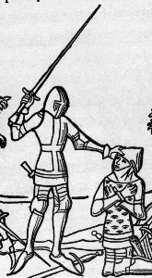
Knights
When considered ready, generally between the ages of eighteen and twenty, a squire was dubbed a knight. This was often performed by the knight who trained him. There were two other ways for one to become a knight. If there was a battle and the King needed additional men, he would knight a number of squires to have enough men to fight. Also, one could become a knight for showing bravery and courage in battle.
Age 18 – 22
Serving lords as warriors
Overseeing land
Taking part in tournaments

Slide 12
Code of Chivalry
Thou shalt believe all that the Church teaches, and shalt observe all its directions.
Thou shalt defend the Church.
Thou shalt respect all weaknesses, and shalt constitute thyself the defender of them.
Thou shalt love the country in the which thou wast born.
Thou shalt not recoil before thine enemy.
Thou shalt make war against the Infidel without cessation, and without mercy.
Thou shalt perform scrupulously thy feudal duties, if they be not contrary to the laws of God.
Thou shalt never lie, and shall remain faithful to thy pledged word.
Thou shalt be generous, and give largess to everyone.
Thou shalt be everywhere and always the champion of the Right and the Good against Injustice and Evil.

